Slide 1

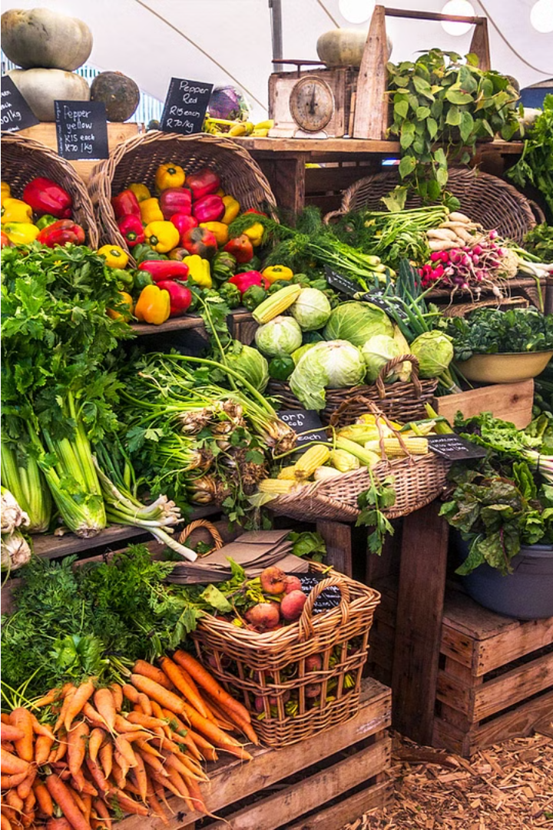
Selling the Finest Raw Food Products
Our mission is to connect consumers with the highest quality raw food products, sustainably sourced from the regions where they are grown best. Through our online platform, we aim to provide a convenient and transparent shopping experience.

Slide 2
Purpose of the Project
Promote Sustainable Farming
Offer Unprocessed Nutrition
Empower Informed Choices
By sourcing directly from small-scale farmers, we support communities and environmentally-friendly agricultural practices.
Our raw, minimally-processed foods retain maximum nutritional value to nourish our customers.
Comprehensive product information allows customers to make educated purchasing decisions.

Slide 3
Technologies Powering our Platform
1
Responsive HTML/CSS/JS Frontend
2
Scalable PHP Backend
Powers smooth order processing and inventory management.
Delivers an optimal user experience across devices.
3
Reliable MySQL Database
4
Secure Payment Processing
Securely stores product data and customer information.
Ensures safe and convenient transactions.

Slide 4



Website Frontend: HTML, CSS, JavaScript
HTML
CSS
JavaScript
Provides the structure and content of web pages.
Styles the visual presentation of the website.
Adds interactive and dynamic functionality.

Slide 5
Website Backend: PHP
Order Processing
Content Management
Handles customer orders and inventory updates.
Enables easy updates to product information and website content.
Security & Authentication
Reporting & Analytics
Safeguards sensitive customer data and prevents unauthorized access.
Provides insights to optimize the business and customer experience.

Slide 6
Database: MySQL
Product Catalog
Stores detailed information about each food product
Customer Accounts
Securely maintains customer profiles and order history
Inventory Management
Tracks stock levels and fulfillment for all items
Order History
Records all past customer orders and transactions

Slide 7




Project Goals
Expand Sustainable Supply
Enhance Customer Experience
Grow Brand Awareness
Onboard more small-scale farmers to increase product variety.
Continuously improve website usability and order fulfillment.
Leverage digital marketing to reach more health-conscious consumers.

Slide 8
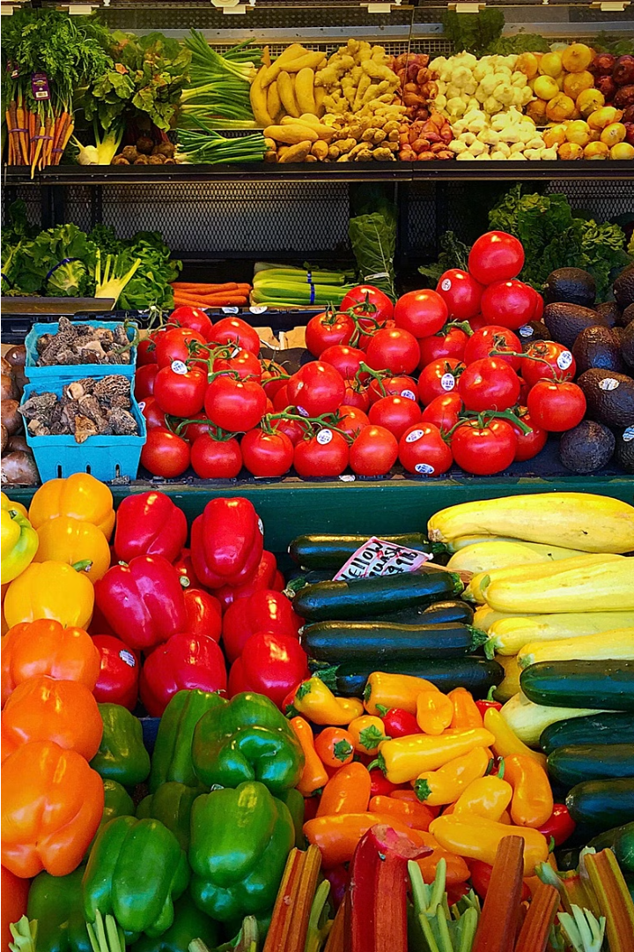
Conclusion
Through our online platform, we are revolutionizing how people access the highest quality raw food products. By empowering informed choices and supporting sustainable agriculture, we aim to nourish our customers and communities.

